Slide 1
CORONA KILLER
Advanced iOS Application Development(MAD_4114_2021S)
Team Members :
Bhavesh Sharma: C0791231
Gaganpreet kaur: C0793779
Patel Krishna: C0807825
Susmitha Vookanti: C0809796
Arshitha Ralla: C0795512

Slide 2
INTRODUCTION:
This iOS Application is basically a game named Corona Killer.
In this game main character is having vaccine in his hand, when corona virus(Enemy) fall towards him he can hit him with the vaccine and kill it.
If Player Touched the virus accidentally, he will dead.
Player can restart the game to play again.

Slide 3
GAME DESCRIPTION:
-: GameViewController:-
This Application Starts with the page namely Login/signup Page by Selecting the Login Option, One need to enter the game with the appropriate credentials, elsewhere if the credentials are wrong error alert will popup.
On the other hand, if one opt for the signup option , It will create a new user account and save the information in the database.
Once the registration is done user will enter into the game. User will be logged in unless he/she logged out.

Slide 4
GAME DESCRIPTION(Continue…):
-:GameScene:-
In the Game Screen , Play button will display to start the game.
Player Characteristics are as follow:
Moves Left to Right as the touch moves
Shoots Vaccine on tap on the screen
Jump on swipe Up
One reward point on killing one virus
With above mentioned characteristics of player, Player can Procced the game.

Slide 5
GAME DESCRIPTION(Continue…):
-:Game Screen:-
On the other hand, Enemy Characteristics are as follow:-
Enemy Virus Swings from top to bottom and moves in any random Position. If the Virus hits the player in the meanwhile player is dead.
Difficulty level increased based on the score exceeds 50 then after score is 100 virus become more faster.

Slide 6
GAME DESCRIPTION(Continue…):
-:Game Over:-
On Player being Killed the details such as current score, exit button, replay button, top 3 players on the scoreboard will be displayed.
By Selecting for replay, the game will restart.
On Selection of exit button, Player will Logout.
Score of each player is saved in Database with their respective user Account.

Slide 7
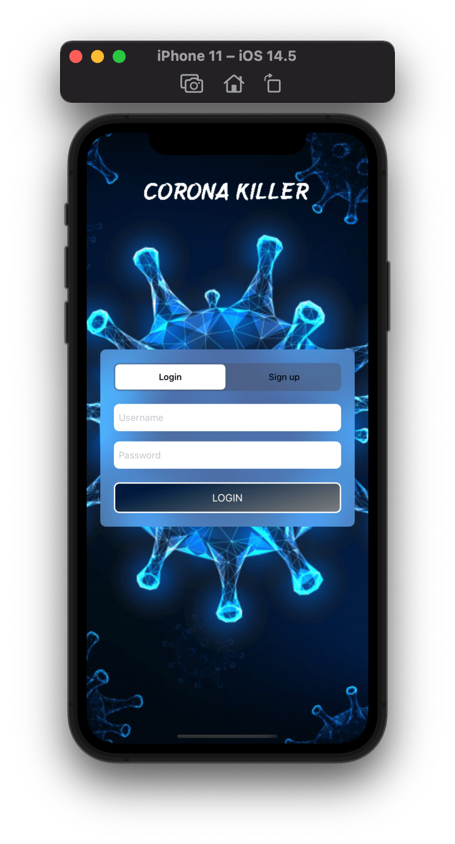
How system works?
System requires login or signup
Initially, this application shows the login screen.
If an existing user, then using the login screen, he/she can enter the Game.

Slide 8
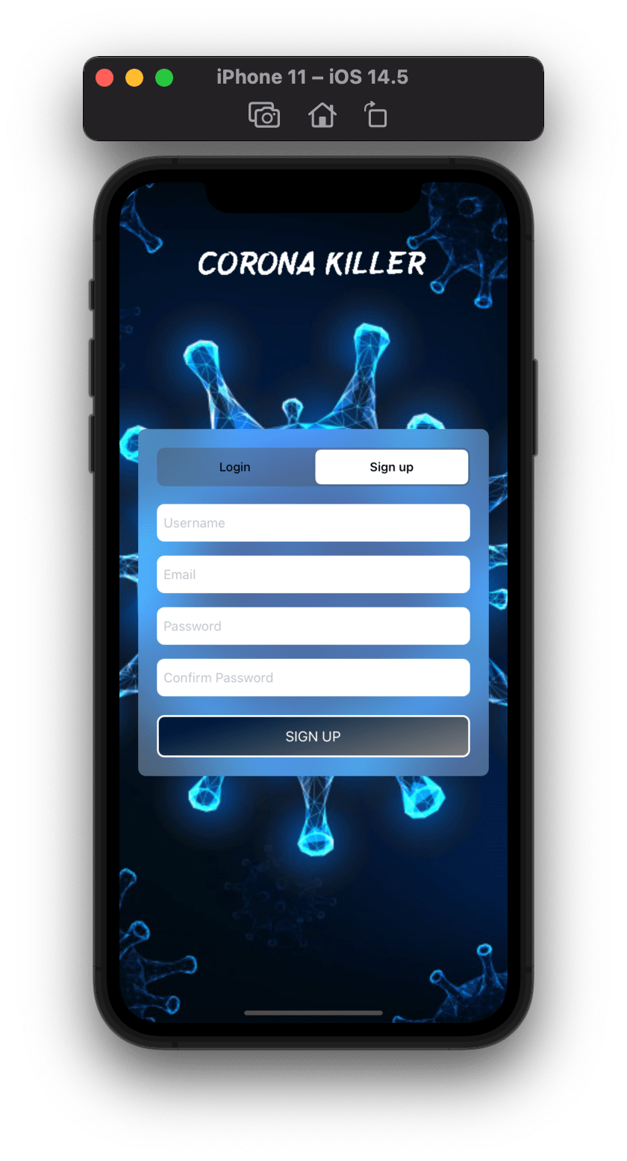
How system works?(Continue)
Register the new User
If there is a new user, then using Sign Up button, users can register themselves.
In the registration process, the user needs to provide some basic information like Username, Email & Password.
Click the Signup Button.

Slide 9
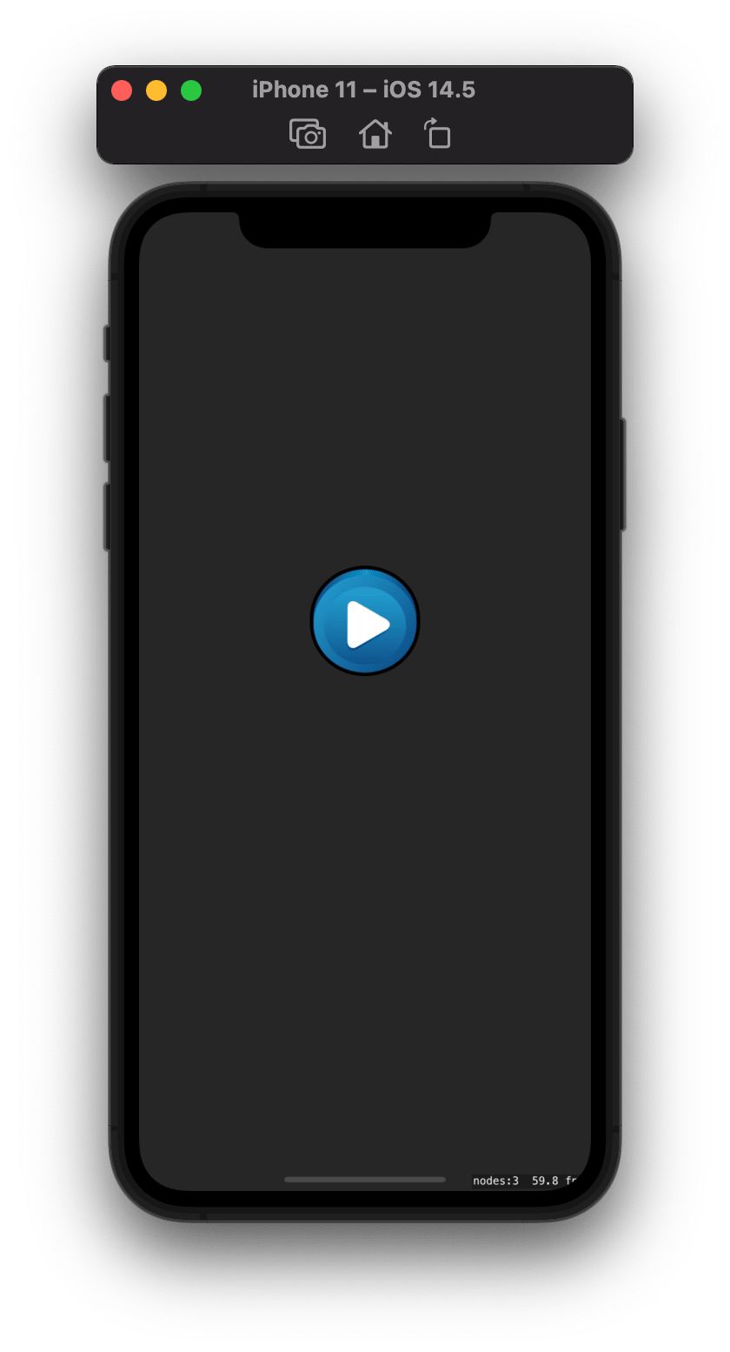
How system works?(Continue)
3) Get Started
Player just need to click the play button to start the Game.

Slide 10
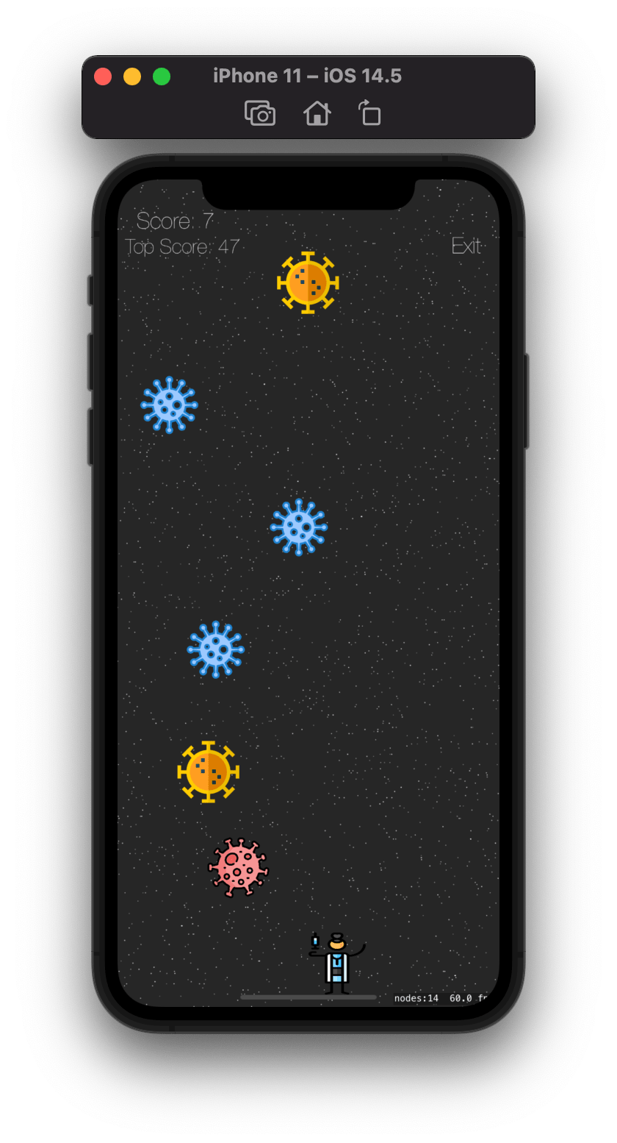
How system works?(Continue)
Main Screen
In this Screen main character is having vaccine in his hand, when corona virus(Enemy) fall towards him he can hit him with the vaccine and kill it.
If Player Touched the virus accidentally, he will dead, and game will over.
Player can exit the Game anytime with the exit button on top right corner moreover he can track his current score on top left corner.

Slide 11
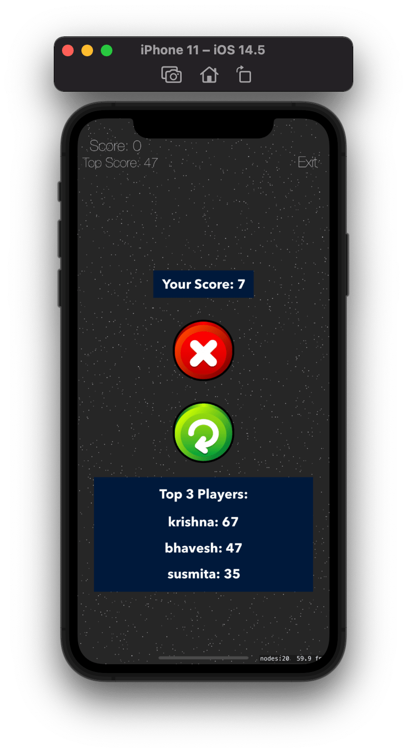
How system works?(Continue)
Game Over
If the user lost the game , he will get this screen.
On this page there will be:-
Your current Score
Exit Button
Replay Button
Score of top 3 Players

Slide 12
Work Distribution
Idea and Core functionality of game like database, player physics, collision, rewards, top 3 score etc. was done by Bhavesh Sharma and Gaganpreet Kaur.
Documentation(pdf), UI idea and all the assets of the game was provided by Patel Krishna.
Login/Signup UI and flow was done by Susmitha Vookanti and Arshitha Ralla.

Slide 13
GitHub Source Code
Corona Killer:- https://github.com/bhavesh18/corona-killer
Video Link:- https://www.dropbox.com/s/xqcxlbh8abf8469/final_project.mov?dl=0

Slide 14
References
https://stackoverflow.com/questions/43336790/dismiss-skscene-go-back-to-uikit-menu
https://www.flaticon.com
https://rebeloper.com/blog/how-to-add-a-button-in-spritekit-and-swift-4-part-1-create-an-iphone-game-using-swift

Slide 15
THANK YOU

